Slide 1



AN AI-ASSISTED MOBILE FINANCIAL TRACKING AND ADVISORY APPLICATION FOR PERSONAL FINANCIAL MANAGEMENT
Presented by: Lucid Frame
Adviser: Mr. Johnny Flores Verzola, MTS
MEMBERS:
  Brix A. Directo
  Cyrille John M. Rubis
  Djaunathan Albert S. Madayag

Slide 2
PRESENTATION OVERVIEW
CHAPTER I — INTRODUCTION
CHAPTER II — DESIGN & METHODOLOGY
  Project Context & The Problem
  Gap of the Study
  What is SmartSpend?
  Conceptual Framework (IPO Model)
  Statements of Objectives
  Scope and Limitations
  Purpose, Description & Beneficiaries
  Technical Background
  Review of Related Literature & Systems
  Research Design
  Population and Locale
  Ethical Considerations
  Data Gathering Tools & Procedures
  Software Methodology (Agile Kanban)

Slide 3
PROJECT CONTEXT
  In today’s digital era, financial management has become increasingly important, especially for young professionals who need to monitor their expenses and manage their budgets effectively. While many mobile applications exist, most still rely heavily on manual input and lack intelligent features that help users understand their financial behavior.
  Traditional financial tracking systems act as passive tools where users manually record expenses and review static summaries. Because of this, users often find expense tracking tedious, leading to inconsistent usage and incomplete records.
  With the advancement of Artificial Intelligence, especially Large Language Models, mobile applications can now interpret natural language and provide smarter, more interactive financial assistance.

Slide 4
THE PROBLEM
  Only 2% of Filipino adults correctly answered all basic financial literacy questions (BSP, 2021)
  Only 46% of Filipinos maintain any household budget (BSP, 2021)
  Only 7% have attended any financial literacy training (BSP, 2021)
  Many households spend beyond monthly income food, transport, utilities outpace savings (PSA FIES, 2021)
  Most Filipinos do not use structured financial tools citing: manual effort, poor local language support, lack of feedback (BSP, 2021)

Slide 5
GAP OF THE STUDY:
  Parents (35–55) primary household financial decision-makers, yet among the lowest in formal financial account ownership and structured budgeting (BSP, 2021)
  Young Professionals (21–35) managing independent income but often without financial literacy training or tools
  Flores (2025) Filipino workers show "come-what-may" attitudes, high debt dependence, reliance on traditional saving methods
  Filipino workers show "come-what-may" attitudes, high debt dependence, reliance on traditional saving methods

Slide 6
WHAT IS SMARTSPEND?
SmartSpend AI-powered mobile financial assistant for Android
  Not just an expense recorder a financial companion
  Key capabilities: Natural language expense input (Filipino-English), Conversational AI (Q&A, prices, guidance), Financial Health Score (0–100), Voice + OCR + barcode + manual input, Offline + cloud sync

Slide 7
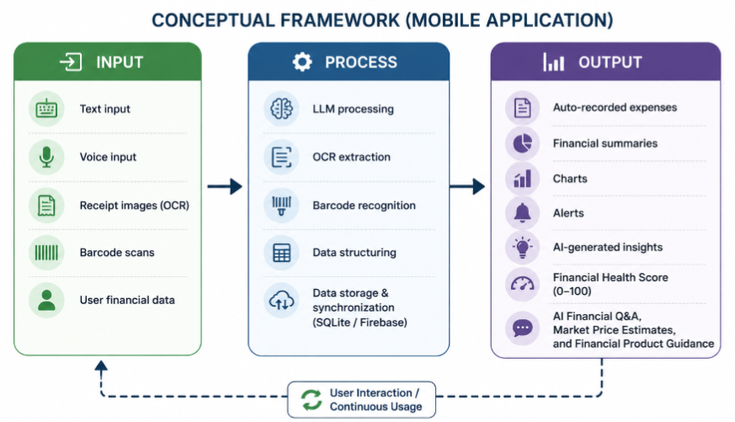
CONCEPTUAL FRAMEWORK

Slide 8
OBJECTIVES
General: Design, develop, and evaluate SmartSpend for parents (35–55) and young professionals (21–35) in La Union
Objective 1: Assess the existing financial management practices, common budgeting challenges, and expense tracking behaviors of the target population through structured surveys and interviews
Objective 2: Design and develop the SmartSpend mobile application — including LLM API integration via context injection architecture, selected through comparative benchmarking
Objective 3: Evaluate the usability of SmartSpend using the System Usability Scale (SUS)

Slide 9
SCOPE AND LIMITATIONS
Scope
Limitations:
  Android only
  offline + cloud
  Filipino-English AI
  Voice + OCR + barcode + manual
  OCR depends on receipt image quality
  AI requires internet connection
  No bank integration (no open-banking APIs in PH)
  No professional financial or tax advice
  Market price estimates may not be real-time
  AI key: 60 requests/day cap for security
  AI does NOT transmit names, account numbers, or personal data to external API

Slide 10
PURPOSE, DESCRIPTION & BENEFICIARIES
  Parents (35–55) - automated tracking, FHS, multi-period summaries; significant financial responsibility with limited access to formal tools
  Budget-conscious individuals - expense control, AI-driven analysis, wallet balances (GCash, Maya, banks)
  Technology enthusiasts - experience AI + LLM in a practical app
  Demo/Evaluation users - Demo Mode, no registration needed
  Note: SmartSpend is a financial companion - NOT a professional financial advisor

Slide 11
TECHNICAL BACKGROUND
  Flutter: Android UI framework (Google)
  SQLite via sqflite: local offline database (14 categories, 9 payment methods)
  Firebase Firestore: cloud sync | Firebase Auth - secure login | Firebase Crashlytics - crash reporting
  LLM API: AI engine (selected via comparative benchmarking: free-tier, fast, Filipino-English capable, modular architecture)
  Google ML Kit: OCR (smart routing: single item → AI chat; 3+ items → import review screen)
  speech_to_text: voice input (en-PH) | mobile_scanner - barcode | System share sheet - JSON backup/restore
  fl_chart: analytics charts | local_auth - biometric login
  Financial Health Score (FHS): 4-component formula, 0–100 (full details in Chapter 3)

Slide 12
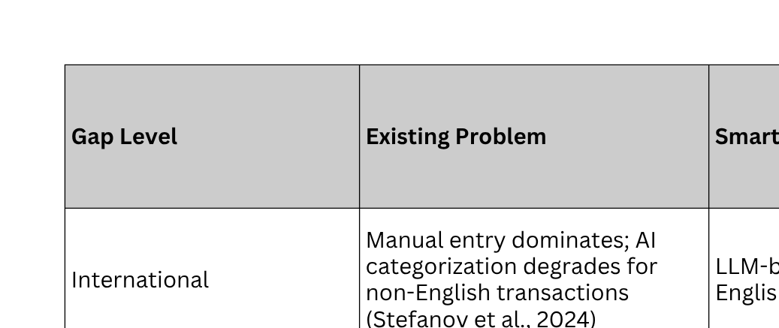
Gap ANALYSIS (3-LEVEL)

Slide 13
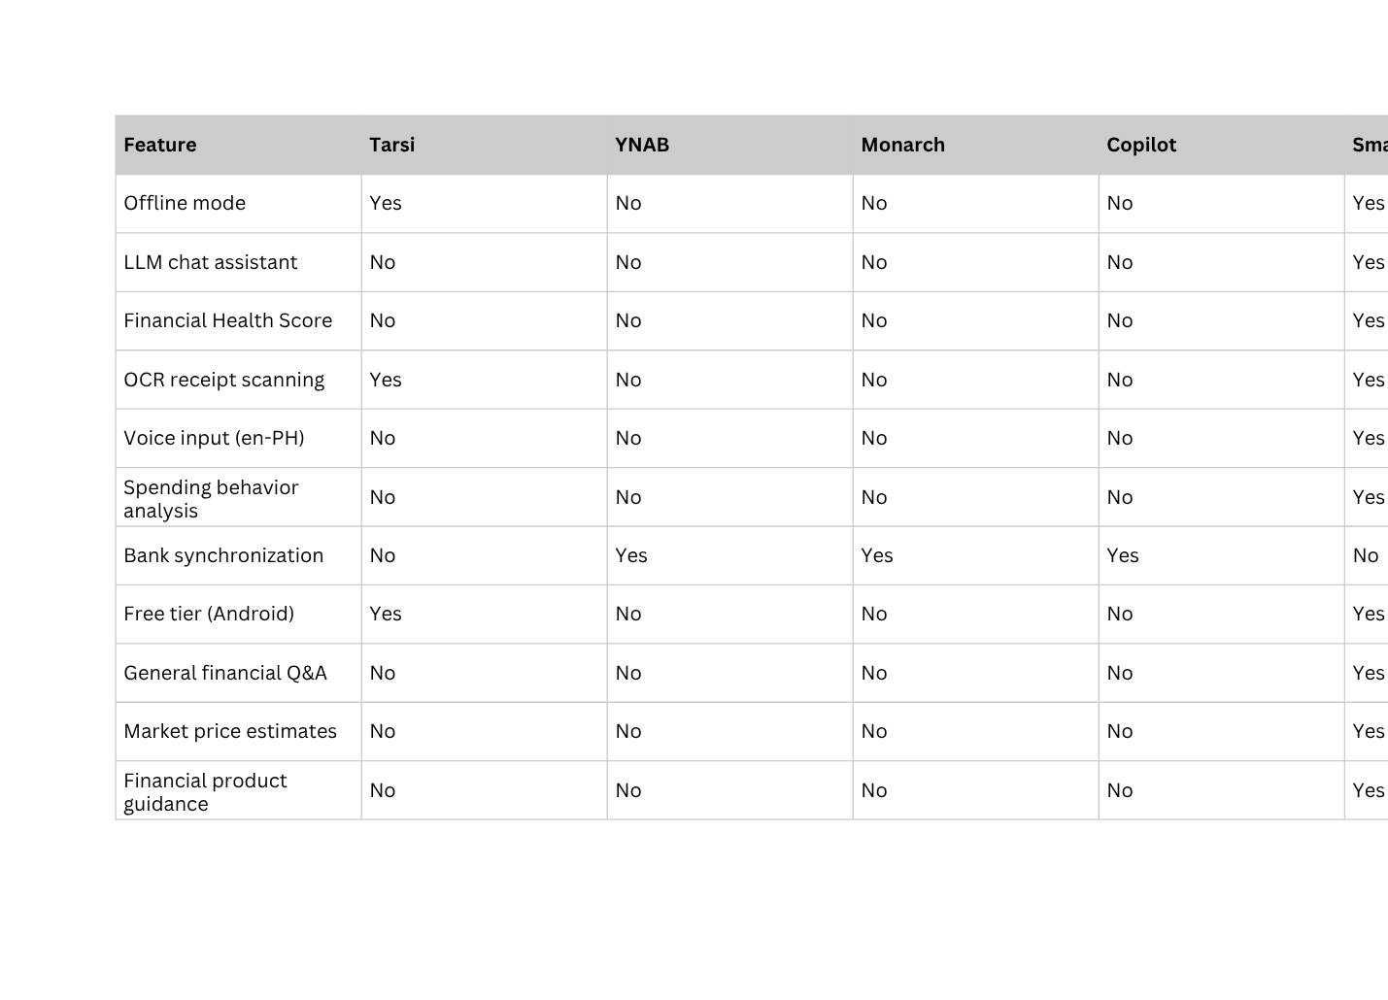
REVIEW OF RELATED SYSTEMS (FEATURE COMPARISON)

Slide 14
LLM COMPARATIVE ANALYSIS
Technical Benchmarking (Objective 2 tool) — Full results in Chapter 3
Evaluated multiple candidate LLM APIs based on:
  Inference speed (response latency)
  Filipino-English accuracy
  Context window capacity
  Cost feasibility (free-tier for academic deployment)
Selected model: best balance of speed, accuracy, and cost Architecture is modular — AI engine can be swapped without rebuilding the entire system

Slide 15
FINANCIAL HEALTH SCORE (FHS) - 0 TO 100
  Think of it as: a grade for your financial habits — not a credit score
  4 components × 25% each:
    Savings Rate — are you saving 20% of income? (based on 50/30/20 rule)
    Overspend Control — how many days did you exceed your budget?
    Budget Adherence — what % of budget categories stayed within limits?
    Logging Consistency — are you recording expenses regularly?
  Score = 25% × each component | Bounded: min 0, max 100
  Consequence System (decay): Day 1 warning ignored → gentle nudge −5pts | Day 2 → stronger warning −5pts | Day 3 → critical alert −5pts | Minimum: 0
  Basis: UNSGSA Framework (2021) on measuring financial health
25%

Slide 16
AI ASSISTANT - THE EXPANDED ROLE
  SmartSpend AI — 6 roles:
  Expense parsing — "paid 150 for groceries" → auto-recorded
  Proactive insights — alerts when spending is unusual or budget nearly exceeded
  General financial Q&A — banking products, SSS, PhilHealth, Pag-IBIG
  Market price estimates — "magkano ang second-hand iPhone 13?"
  Buying & selling advice — "is this a good deal for my situation?"
  Financial planning — "how do I split my ₱18,000 salary?"
  Privacy: Only anonymized descriptions → API. No names, no account numbers, no personal data.
  Efficiency: Conversation summarization — compressed summary replaces full chat history in API calls

Slide 17
RESEARCH DESIGN & METHODOLOGY
  Mixed methods: qualitative (interviews) + quantitative (surveys + SUS)
  Descriptive-developmental: design, build, and evaluate a functional system
  SUS — System Usability Scale:
    Developed by Brooke (1996), validated Bangor et al. (2009)
    10 standard questions, answered after using the system
    Score: 0–100 | 80+ = Good ← our target
    Administered to all 30 respondents after live demo

Slide 18
POPULATION AND LOCALE
  Location: San Fernando City, La Union
  Respondents (n=30): Parents 35–55 (n=20) + Young Professionals 21–35 (n=10)
  Sampling: Purposive — intentionally selecting individuals with financial management experience
  Validators:
    Survey Content Validator: Susan C. Arquisal — BS Commerce (Management), Active Business Owner
    SUS Process Reviewer: Benjie G. Bucasas — BS IT cum laude, IT Team Lead

Slide 19
AGILE KANBAN METHODOLOGY
  Agile Kanban — flexible, visual task management for software development
  Tasks move across a board: Backlog → Requirements → Design → Development → Testing → Deployment → Done/Review
  Phases can overlap or repeat — unlike rigid sequential models
  WIP limits prevent overload and maintain focus

Slide 20
ETHICAL CONSIDERATIONS & DATA GATHERING
  VOLUNTARY PARTICIPATION | INFORMED CONSENT | FULL CONFIDENTIALITY | ACADEMIC USE ONLY
  OBJECTIVE 1: SURVEY (VALIDATED: SUSAN ARQUISAL) + INTERVIEWS
  OBJECTIVE 2: NO INSTRUMENT — DEVELOPMENT PHASE + LLM TECHNICAL BENCHMARKING
  OBJECTIVE 3: SUS QUESTIONNAIRE (PROCESS REVIEWED: BENJIE BUCASAS) + ADDITIONAL FEEDBACK

Slide 21
SUMMARY
  Problem: Only 2% full financial literacy (BSP 2021); parents are primary decision-makers but underserved; Filipino households overspend
  Gap: No app combines Filipino-English AI + offline + FHS + no bank integration needed
  Solution: SmartSpend — AI-assisted, offline, multi-modal, full financial companion
  Target: Parents (35–55) + Young Professionals (21–35), La Union, n=30
  Key innovations: FHS (0–100, 4 components) + Expanded AI (6 roles) + Consequence System + Conversation Summarization
  Method: Mixed methods + Agile Kanban + LLM comparative benchmarking + SUS (target: 80+)
  Validators: Susan C. Arquisal (survey) | Benjie G. Bucasas (SUS process)

Slide 22
MARAMING PONG SALAMAT!
SMARTSPEND — SPEND SMART, LIVE BETTER.
WE WELCOME YOUR QUESTIONS AND FEEDBACK AFTER THE DEMO VIDEO.

